Slide 1
Cybersecurity
Cross-site Request Forgery

Slide 2
Cross-site Request Forgery
One-click attack, session riding
XSRF
CSRF (sea surf)
Exploits trust relationship between web app and user
The website trusts you
Fulfills your requests (well, requests from you)
Web development weakness
Web apps should have checks and anti-forgery built-in
Cryptographic token helps prevent forged requests

Slide 3

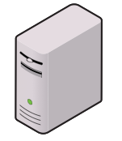

Cross-site Request Forgery
Bank Customer
Pssst. Say, “Send money to 44.73.5.73”
Bank Server
Hacker

Slide 4
Cross-site Request Forgery
Send money to 44.73.5.73
Bank Customer
Bank Server
Hacker

Slide 5

Cross-site Request Forgery
Bank Customer
Bank Server
Ok, got it. You have the funds. I’ll send money to 44.73.5.73
Hacker

Slide 6

Cross-site Request Forgery
Bank Customer
Bank Server
Thank you! kthxbye
Hacker

Slide 7
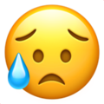
Cross-site Request Forgery
I didn’t want to do that!!!
Bank Server
But you told me to!
Bank Customer

